Slide 1
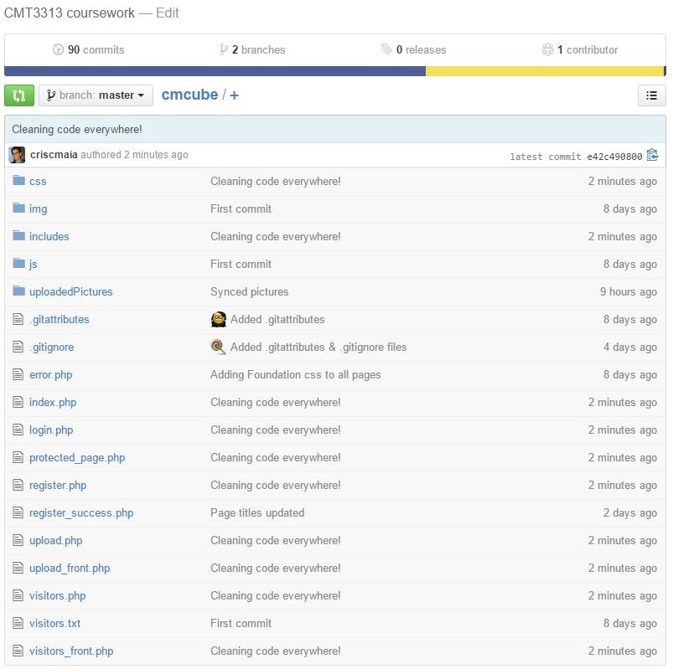
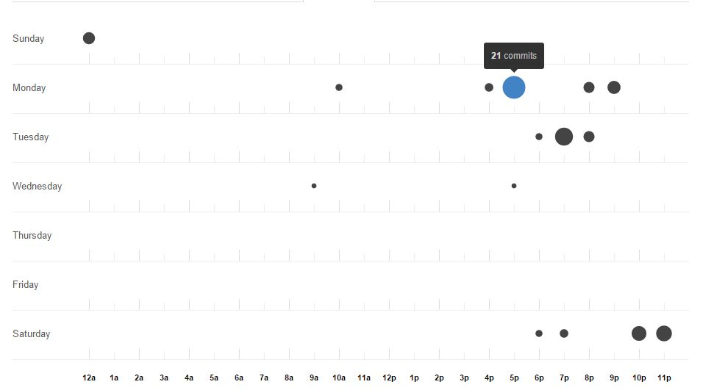
I've been using GitHub to manage my code: https://github.com/criscmaia/cmcube
This is the overview screenshot
And this is my punch card screenshot

Slide 2
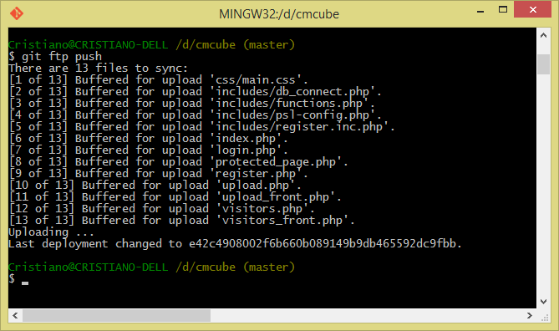
To make my job more efficient I've set up an automatic way to sync the changes on GitHub with my ftp server using Git Bash (git ftp push)

Slide 3
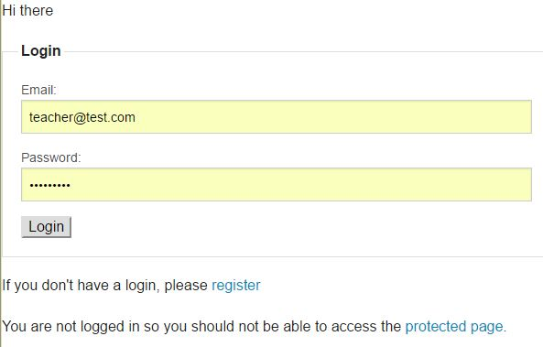
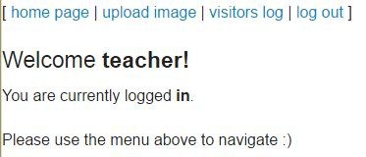
Now let me show the website interface/functionalities
This is the home page with saved login details
And this is the message after you login

Slide 4
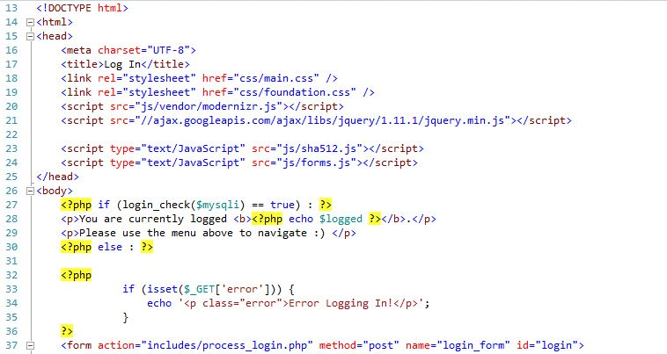
On the code side of the login section
Highlights:
As you can see on line 23, I import the sha512.js file. This is part of the CryptoJS collection.
The CryptoJS is a collection of standard and secure cryptographic algorithms implemented in JavaScript using best practices and patterns.
Source: https://github.com/Caligatio/jsSHA
I’ve also implemented a functionality that prevents brute force attack.
It records all the tentative of access for the last two hours on the same username.
After the 10th try, the following tries will be automatically ignored, even if the details are correct.
function checkbrute($user_id, $mysqli) {
$now = time();
$valid_attempts = $now - (2 * 60 * 60);
if ($stmt = $mysqli->prepare("SELECT time FROM login_attempts WHERE user_id = ? AND time > '$valid_attempts'")) {
$stmt->bind_param('i', $user_id);
$stmt->execute();
$stmt->store_result();
if ($stmt->num_rows > 10) {
return true;
} else {
return false;
}
}
}

Slide 5
On the code side of the register section
As expected, the CryptoJS collection is also used on the registration page. The whole code can be accessed in GitHub [ Front end | Back end ].
This are some of the highlights:
All the input data are sanitized and validated.
Checks if a user with this username already exists.
Here is when the passwords is being encrypted.
$username = filter_input(INPUT_POST, 'username', FILTER_SANITIZE_STRING);
$email = filter_input(INPUT_POST, 'email', FILTER_SANITIZE_EMAIL);
$email = filter_var ($email, FILTER_VALIDATE_EMAIL);
$prep_stmt = "SELECT id FROM members WHERE username = ? LIMIT 1";
$random_salt = hash('sha512', uniqid(mt_rand(1, mt_getrandmax()), true));
$password = hash('sha512', $password . $random_salt);

Slide 6
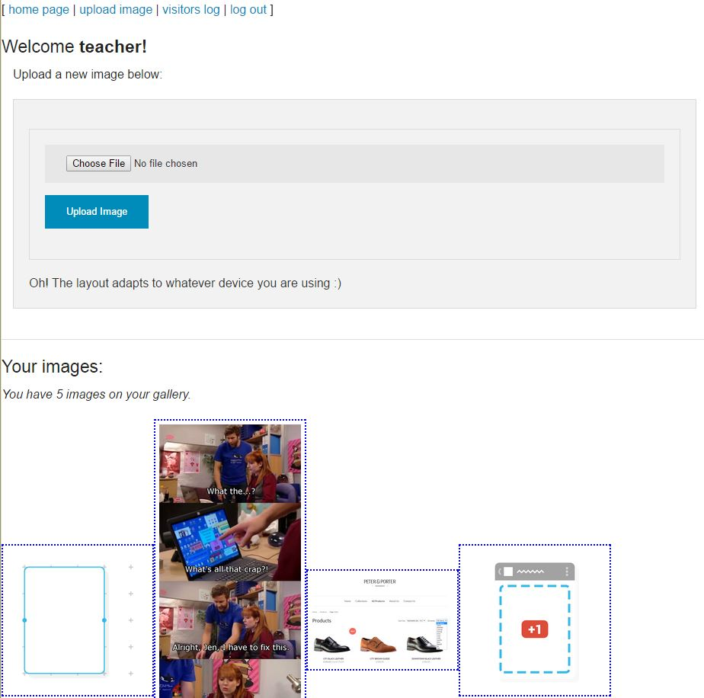
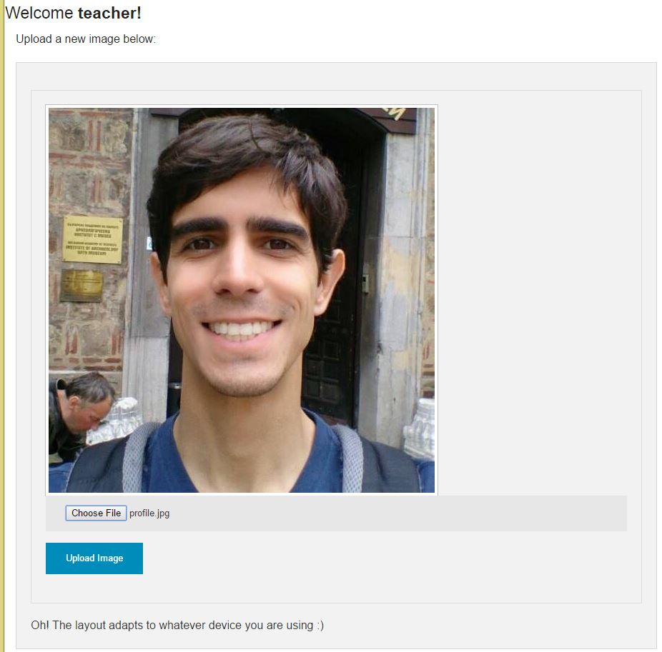
After the user has logged in, this is the main page where they can upload new images or access its library
Overview of the page
Thumbnail after the user selects the image

Slide 7
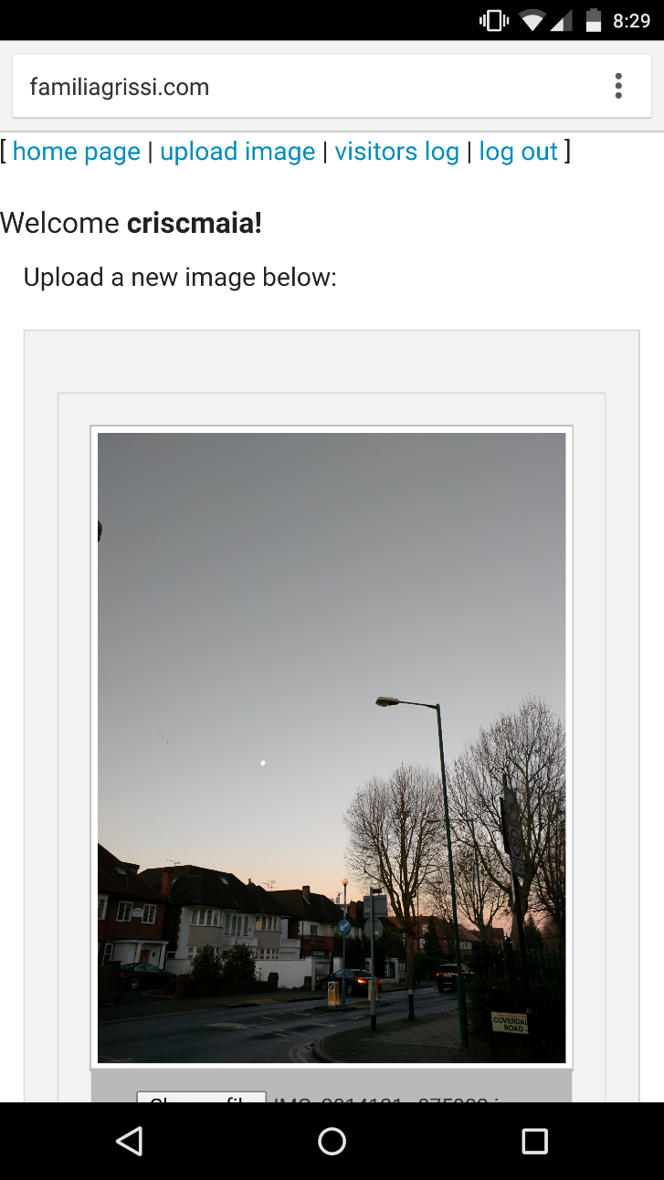
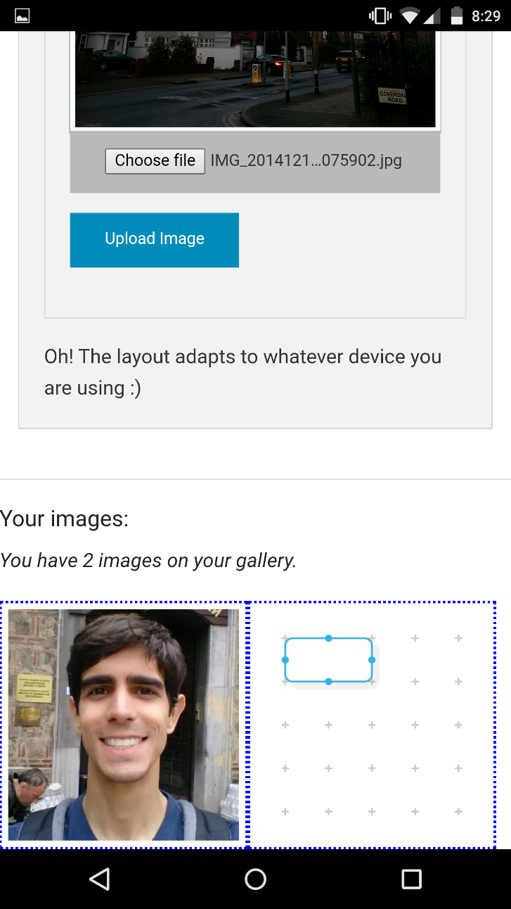
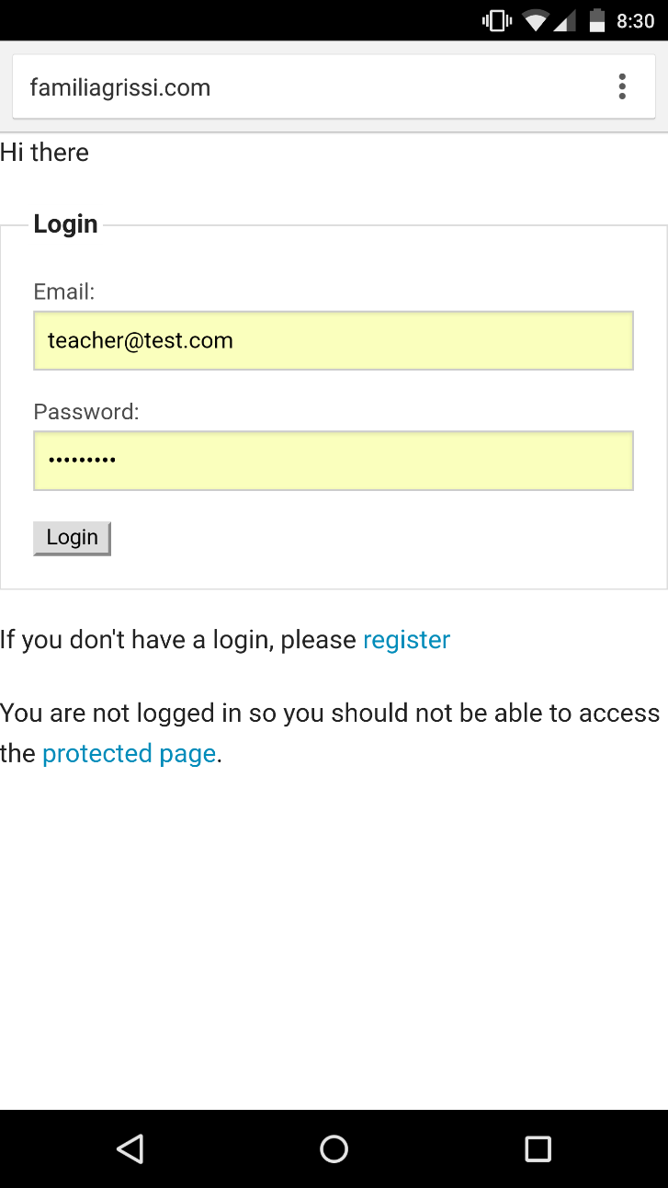
The interface is also 100% mobile user-friendly (tested on Chrome running on a Nexus 6)
Main page with thumbnail
Gallery part
Login page

Slide 8
Highlights of the code side for the upload section
if ($_FILES['profileToUpload']['size'] > 1000000) {
throw new RuntimeException('Exceeded filesize limit.');
}
Size limit implemented
Malicious scripts can be hidden on files that has an image extension.
To prevent it, the system is currently checking the MIME type of the file instead of checking if it ends with jpg, png or gif.
Links the image uploaded to the user
Calculates the sha1 hash of the file specified by filename using the US Secure Hash Algorithm 1, and returns that hash.
This hash will be the filename to guarantee its unique.
$finfo = new finfo(FILEINFO_MIME_TYPE);
if (false === $ext = array_search(
$finfo->file($_FILES['profileToUpload']['tmp_name']),
array(
'jpg' => 'image/jpeg',
'png' => 'image/png',
'gif' => 'image/gif',
),
true
)) {
throw new RuntimeException('Invalid file format.');
}
($insert_stmt = $mysqli->prepare("INSERT INTO image_access (username, filename) VALUES (?, ?)")
sprintf('./uploadedPictures/%s.%s', sha1_file($_FILES['profileToUpload']['tmp_name']),

Slide 9
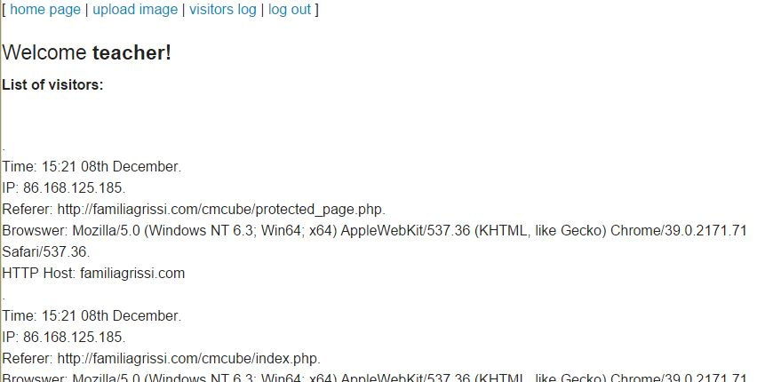
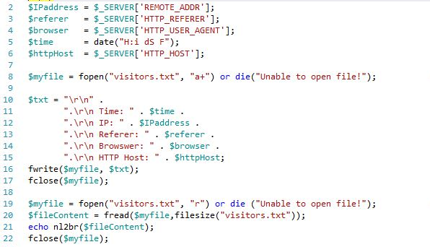
Visitor section
I have also included the Visitors Log page. As the name says, it keep track of the visitors by collecting information such as the time they visited the page, its IP address, what page they are coming from, and the browser they are using.
This code is fairly simple as the PHP library provides has already implemented the final variables.
I am currently recording it on a simple text file for testing purpose but it should be implemented in a database in real life scenarios.

